Slide 1
Predicting Customer Relationship from KDD Cup 2009 Data Set
Statistical Data Mining Course Project
邱家良 王瑋勇
Department of Statistics
National Cheng Kung University
Tainan, Taiwan
Date : 2013/06/06

Slide 2
Outline
Problem Description
Data Overview
Literature Review
The idea of Analysis Procedure
Data Processing
Building Model
Problem we meet
Preview
Reference

Slide 3
Problem Description
KDD CUP 2009
Supported by Orange (French Company)
Customer Relationship Management (CRM)
predict the propensity of customers
switch provider (churn)
buy new products or services (appetency)
buy upgrades or add-ons proposed to them to make the sale more profitable (up-selling).
Make Good Predictions of Target Variables with high accuracy
Interpretable: selected predictive variables must be insightful

Slide 4
Data Description
Two datasets given
training & test (Target Label isn’t available!) datasets
Dimension
50,000 instances x 15,000 input variables
About 1.7GByes
14,740 numerical variables, 260 categorical variables
Problems
High Missing Values
High Variance
High Range

Slide 5
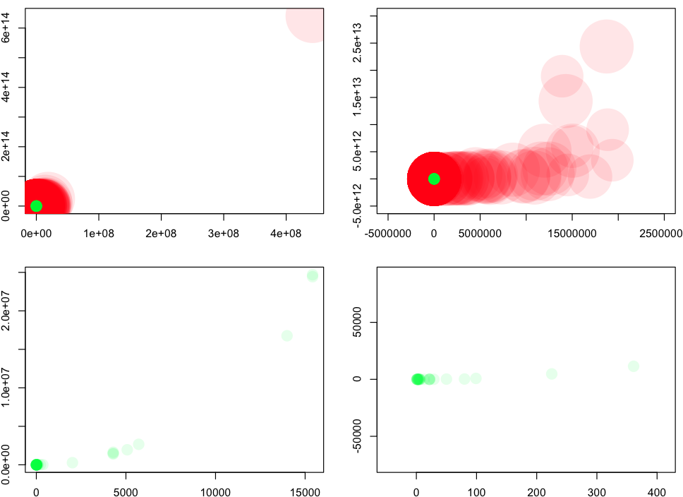
Data Description (SMALL DATA)
Red=Continous Variable Green=Category Variable
Size=the scale of MIssing

Slide 6
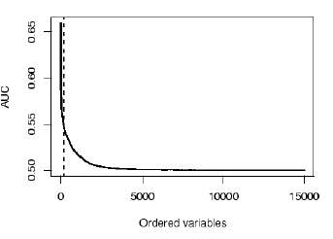
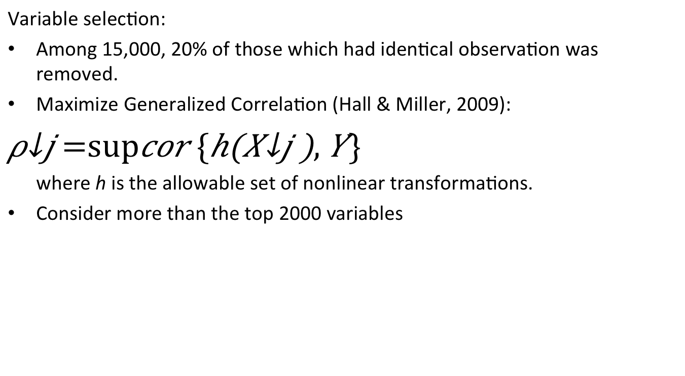
Literature Review Miller et al. (2009), The University of Melbourne’s KDD Cup Report
Variable selection:
Among 15,000, 20% of those which had identical observation was removed.
Maximize Generalized Correlation (Hall & Miller, 2009):
$$ρ_{j}=\sup{cor \{h\left(X_{j}\right), Y\}}$$
where h is the allowable set of nonlinear transformations.
Consider more than the top 2000 variables

Slide 7
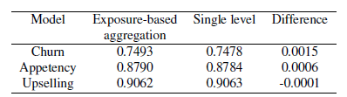
Literature Review Miller et al. (2009), The University of Melbourne’s KDD Cup Report
Categorical variables: High levels (up to more than 10,000)
Treatment:
Keeping any levels that had at least 1000 observations worth of exposure
Aggregating any levels between 500-999 into a new level
Aggregating any levels between 250-599 into a new level
Aggregating any levels between 1-250 into a new level
Table: AUC based on exposure-based aggregration

Slide 8
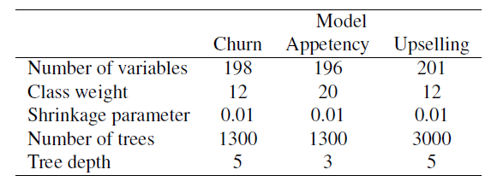
Literature Review Miller et al. (2009), The University of Melbourne’s KDD Cup Report
Modelling: Boosted Tree Models
Usefulness of a variable: evaluated by reduction of binary loss to the model. Around 200 variables were selected in each model.
Positive cases were given weights to yield roughly equal weight for each cases.
Team | Churn | Appetency | Upselling | Average
IBM | 0.7651 | 0.8819 | 0.9092 | 0.85206
Univ. Melbourne | 0.7570 | 0.8836 | 0.9048 | 0.84847
Table: Final Model Performance
Table: Model Parameters for boosted tree models
Notes:
Expected Value of AUC

Slide 9
Analysis Procedure Overview
Data Processing
Imputation
Filter
Building Model
Regression Tree
Boosting
Testing and Comparing
CV, ROC
Comparing the past result in 2009

Slide 10
Analysis Procedure Data Processing
High missing value is the major problem of original data set.
Filter
Abandoning the variables that contains more than 95% of NAs
Imputation
According to the categories we set( 2 categories)
If some variables only have one category but having NA<- replace the value to 0 & 1

Slide 11
Analysis Procedure Data Processing
Setting Categories:
Variables that contains 5~95% of NAs
Variables that contains 5% less NAs
Category 1:
Imputation method: Regression Tree(Doetsch et al., 2009)
Category 2:
For numerical variables, impute NA by mean of the corresponding variable.
For categorical variables, impute NA by mode of the corresponding variable.

Slide 12
Analysis Procedure Data Processing
Var1 | Var2 | Var3 | Var4
124 | 0 | 5 | 0
135 | 0 | 6 | 1
341 | 1 | 3 | 1
342 | 0 | 1 | NA
453 | 1 | 9 | NA
Build Regression tree to predict the NA Value
For example:
Var1~3 as X
Var4 as a Y

Slide 13
Analysis Procedure Building Model
Final Model
Category 1 Model
Category 2 Model
Category 3 Model
(No Any NA)
Model :
Tree or Boosting Tree
The Y hat depend on Category 1 to 3 Vote.

Slide 14
Problems
Server, Server and Server
Not work to run our code (Small data is work in our pc or mac!)
Test data miss the target label
Solution: slice the original train data to train data and test data, with 70% and 30% respectively.
Final Solution
Using our own computer :’(
Cutting the train data as five to ten parts , and utilizing such parts to cross validation.

Slide 15
What’s New
Data processing
Imputation ( Replace the value to 0 & 1 )
Model building
3 categories Model - > Final Model
More easy understanding
Maybe more accuracy

Slide 16
Preview next week
Result
Calculate the result
Comparing different method in differing categories(1~3)
Plot ROC Curve to analyze our model
Comparing the result from the KDD 2009 Cup Winner

Slide 17
References
Patrick Doetsch(2009) Logistic Model Trees with AUC Split Criterion for the KDD Cup 2009 Small Challenge.The Journal of Machine Learning Research : Workshop and Conference Proceedings 2009 pages 1-12
IBM Research: Winning the KDD Cup Orange Challenge with Ensemble Selection. In: JMLR W&CP, vol. 7 (2009)
Xie, J., Rojkova, V., Pal, S., Coggeshall, S.: A Combination of Boosting and Bagging for KDD Cup 2009 - Fast Scoring on a Large Database. In: JMLR W&CP, vol. 7 (2009)
The KDD Cup 2009 Results (Online) (2009), http://www.kddcuporange.com/results.php?ds=small
Hastie. T., Tibshirani, R., and Friedman, J.(2001) , The elements of Statistical Learning, New York: Springer-Verlag.

Slide 18
Preprocessing result:
Dimension reduction:
From 15,000 to ???
No more NA values

Slide 19
Classifier: tree
very few of +1 cases -> assign weight
Result
 | Training error | Test error
Appetency
Churn
Upselling

